Slide 1
interfaces

Slide 2
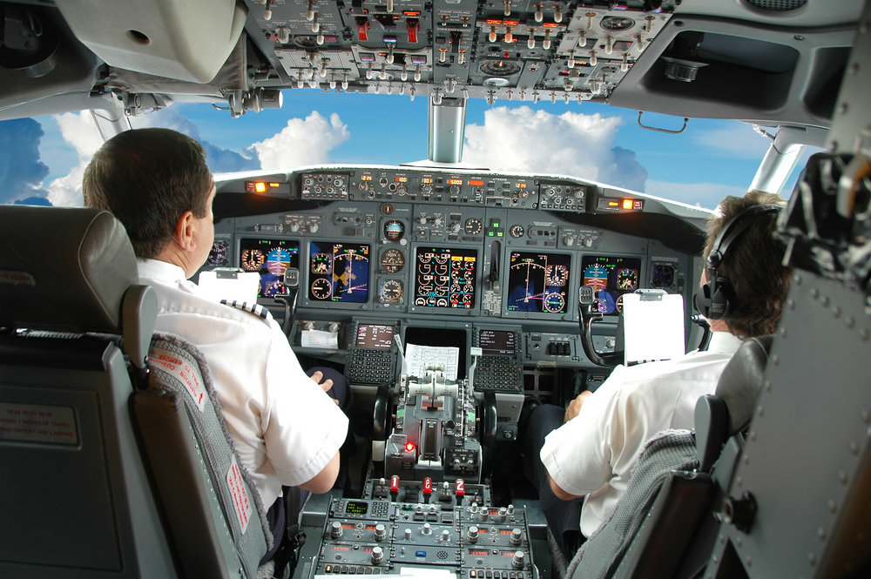

Slide 3
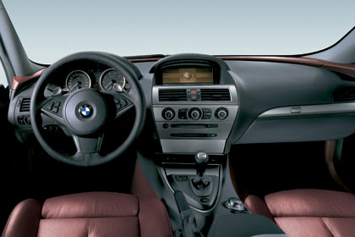

Slide 4


Slide 5


Slide 6
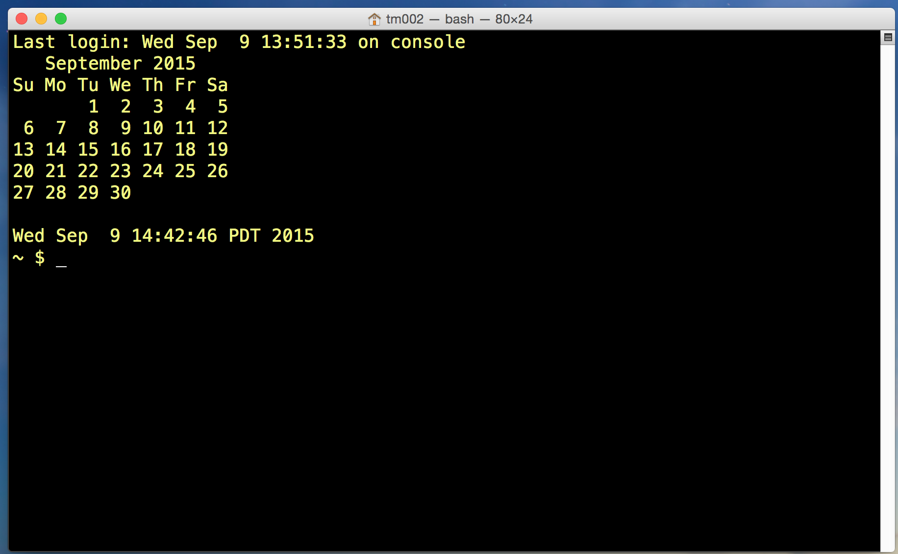

Slide 7
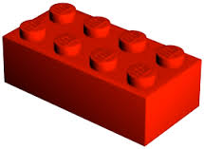
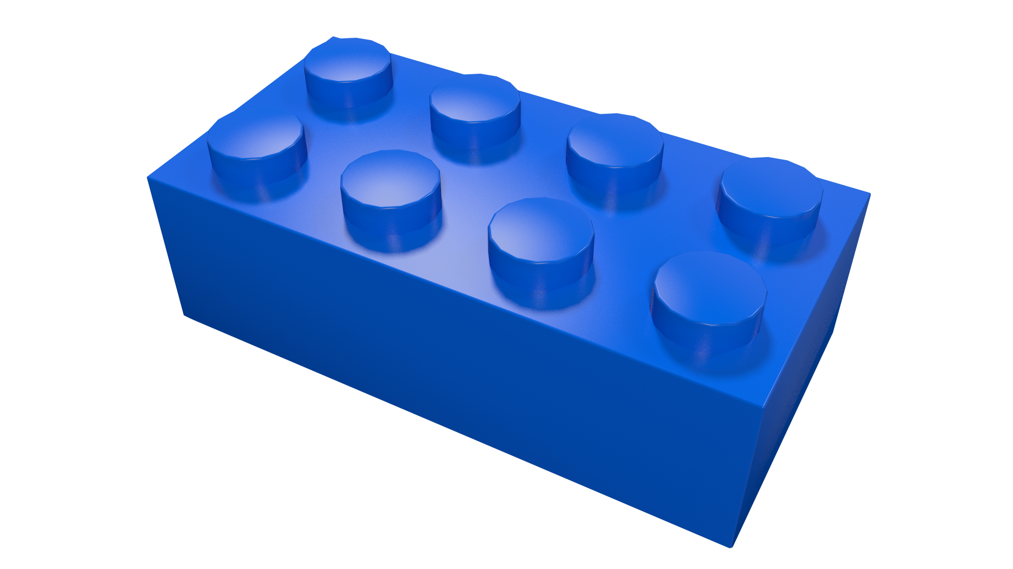

Slide 8
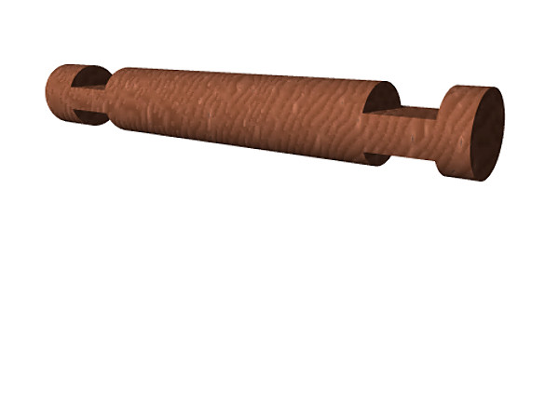

Slide 9
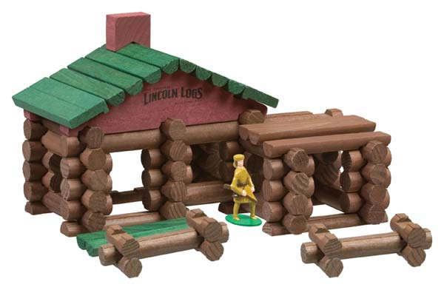

Slide 10
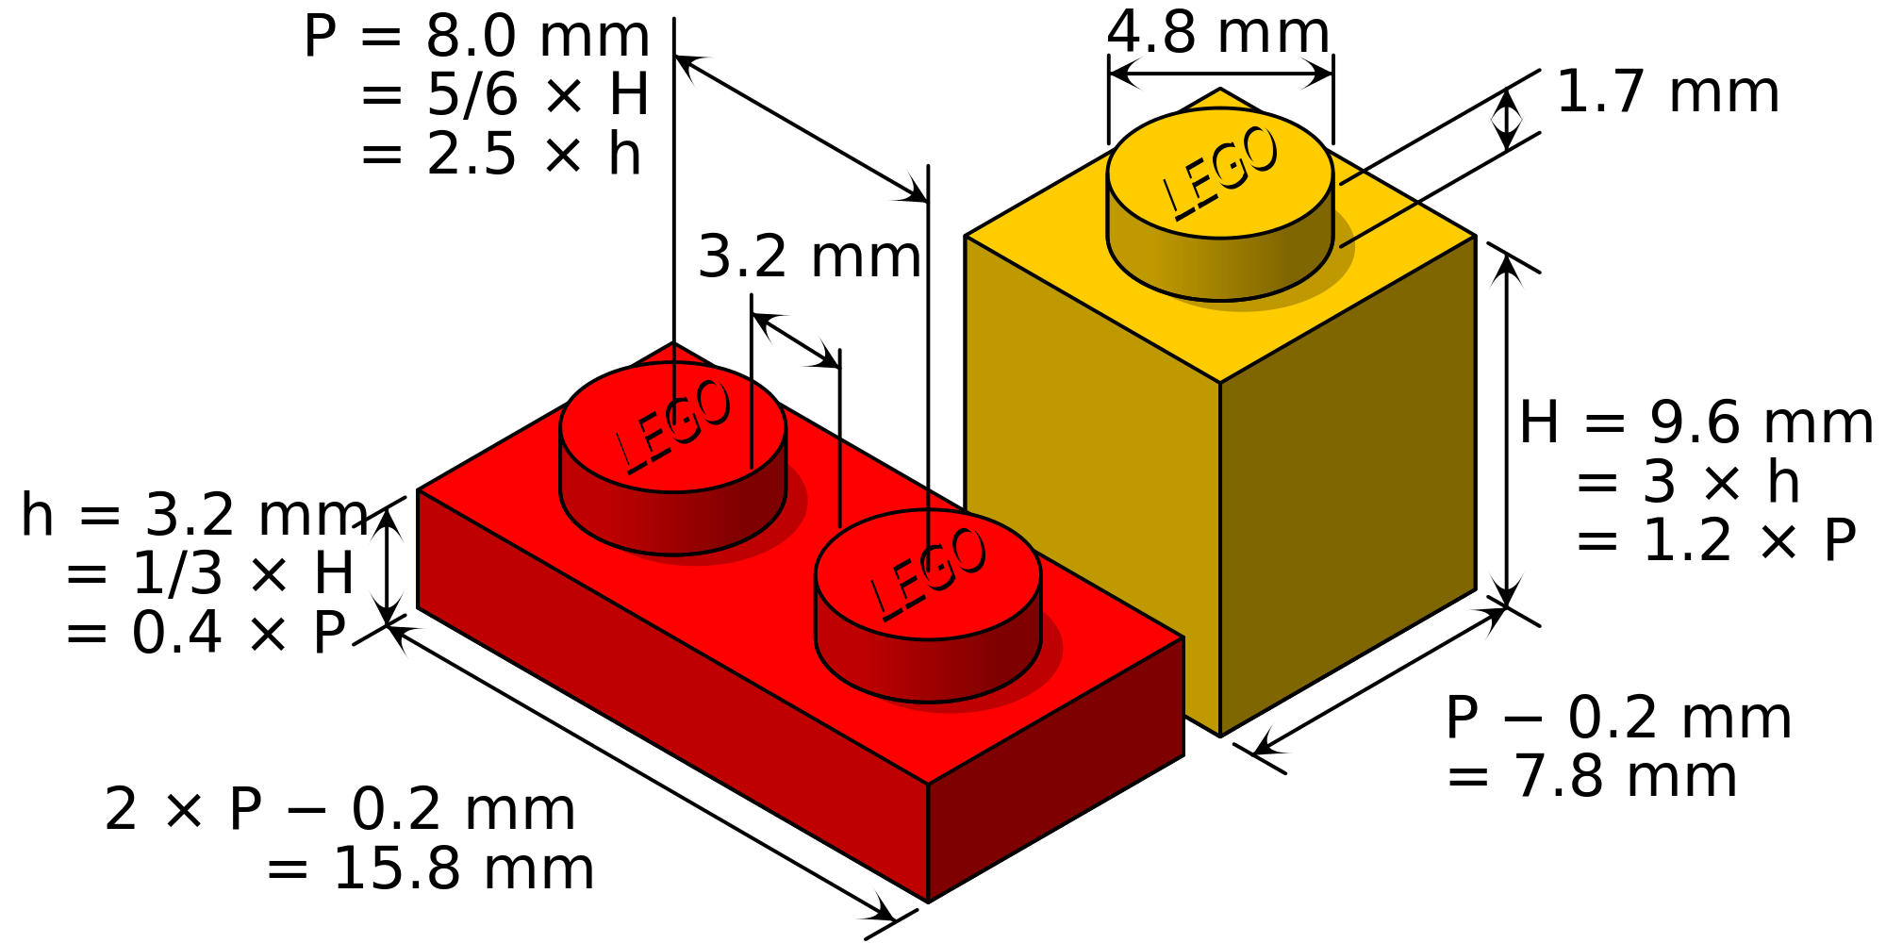

Slide 11
interface
A common interface allows things to fit together.

Slide 12
interface
Interfaces allow one thing to interact with another.
A common interface allows things to fit together.

Slide 13
interface
Interfaces allow one thing to interact with another.
An interface allows one thing to work with another.
A common interface allows things to fit together.

Slide 14
interface
Interfaces allow one thing to interact with another.
An interface allows one thing to work with another.
A common interface allows things to fit together.
These are all perfect descriptions of how we use interfaces in programming

Slide 15
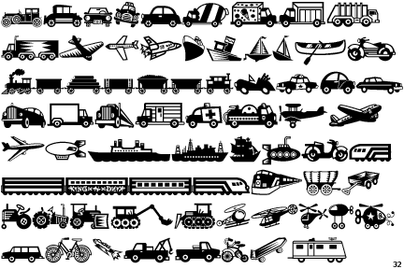
interface analogy
say I need to go from here to LA
I’ll need a vehicle to get there:
car, truck, bike, plane
all of those different modes of transportation implement the “vehicle interface”
they all satisfy the criteria for what it means to be a vehicle
a police officer might have a rule, “a vehicle can’t go through a red light”
a police officer could then pull you over if you went through a red light on a bike, motorcycle, car …
all of those different modes of transportation implement the “vehicle interface”
they all satisfy the criteria for what it means to be a vehicle

Slide 16
interface analogy
You could say
interfaces allow us to group things
by functionality; what they do; their methods
say I need to go from here to LA
I’ll need a vehicle to get there:
car, truck, bike, plane
all of those different modes of transportation implement the “vehicle interface”
they all satisfy the criteria for what it means to be a vehicle
a police officer might have a rule, “a vehicle can’t go through a red light”
a police officer could then pull you over if you went through a red light on a bike, motorcycle, car …
all of those different modes of transportation implement the “vehicle interface”
they all satisfy the criteria for what it means to be a vehicle

Slide 17
interface analogy
You could say
interfaces allow us to group things
by functionality; what they do; their methods
say I need to go from here to LA
I’ll need a vehicle to get there:
car, truck, bike, plane
all of those different modes of transportation implement the “vehicle interface”
they all satisfy the criteria for what it means to be a vehicle
a police officer might have a rule, “a vehicle can’t go through a red light”
a police officer could then pull you over if you went through a red light on a bike, motorcycle, car …
all of those different modes of transportation implement the “vehicle interface”
they all satisfy the criteria for what it means to be a vehicle
An interface is like
having more than one type:
“I’m a plane, and I’m a vehicle”
“I’m a truck, and I’m a vehicle”
“I’m a boat, and I’m a vehicle”

Slide 18
interface analogy
You could say
interfaces allow us to group things
by functionality; what they do; their methods
say I need to go from here to LA
I’ll need a vehicle to get there:
car, truck, bike, plane
all of those different modes of transportation implement the “vehicle interface”
they all satisfy the criteria for what it means to be a vehicle
a police officer might have a rule, “a vehicle can’t go through a red light”
a police officer could then pull you over if you went through a red light on a bike, motorcycle, car …
all of those different modes of transportation implement the “vehicle interface”
they all satisfy the criteria for what it means to be a vehicle
An interface is like
having more than one type:
“I’m a plane, and I’m a vehicle”
“I’m a truck, and I’m a vehicle”
“I’m a boat, and I’m a vehicle”
An interface is like
having more than one type:
“I’m a file, and I’m a reader interface”
“I’m a string, and I’m a reader interface”
“I’m a file, and I’m a writer interface”

Slide 19
interface analogy
You could say
interfaces allow us to group things
by functionality; what they do; their methods
say I need to go from here to LA
I’ll need a vehicle to get there:
car, truck, bike, plane
all of those different modes of transportation implement the “vehicle interface”
they all satisfy the criteria for what it means to be a vehicle
a police officer might have a rule, “a vehicle can’t go through a red light”
a police officer could then pull you over if you went through a red light on a bike, motorcycle, car …
all of those different modes of transportation implement the “vehicle interface”
they all satisfy the criteria for what it means to be a vehicle
An interface is like
having more than one type:
“I’m a plane, and I’m a vehicle”
“I’m a truck, and I’m a vehicle”
“I’m a boat, and I’m a vehicle”
An interface is like
having more than one type:
“I’m a file, and I’m a reader interface”
“I’m a string, and I’m a reader interface”
“I’m a file, and I’m a writer interface”
ioutil.ReadAll takes a reader interface as an argument,
so it can take a file or a string:
func ReadAll(r io.Reader) ([]byte, error) { }

Slide 20
interface
a type
which defines a set of methods

Slide 21
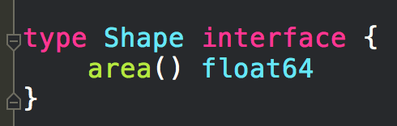
interface
a type
which defines a set of methods
any type which has an area() float64 method
implements the Shape interface

Slide 22
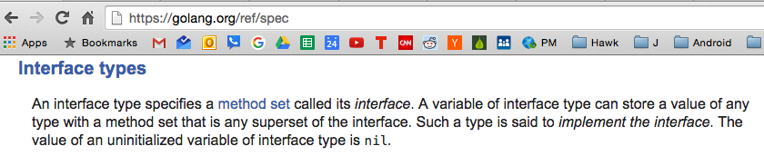
https://golang.org/ref/spec

Slide 23
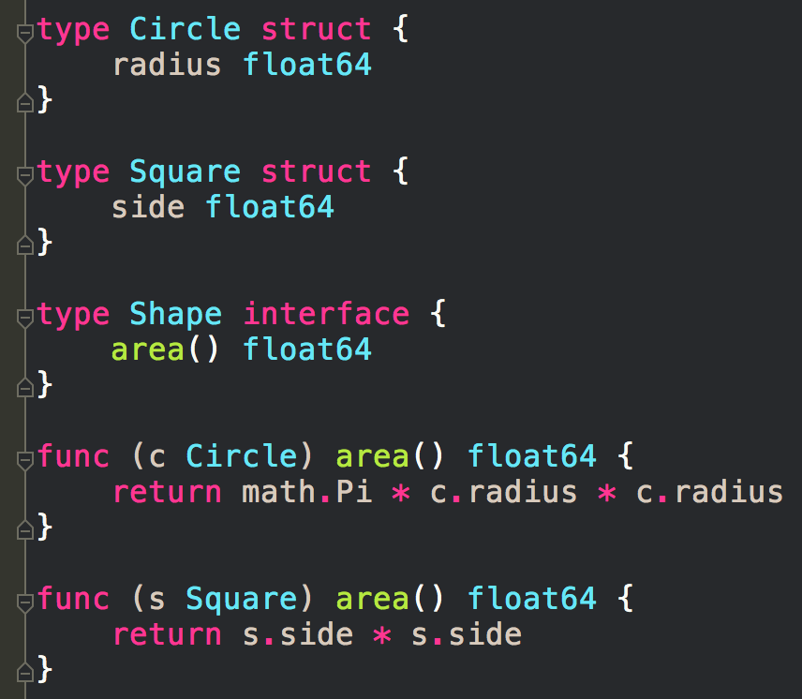
Are there any types here that implement the Shape interface?
any type which has the methods defined by the Shape interface
implements the Shape interface

Slide 24
Are there any types here that implement the Shape interface?
any type which has the methods defined by the Shape interface
implements the Shape interface

Slide 25
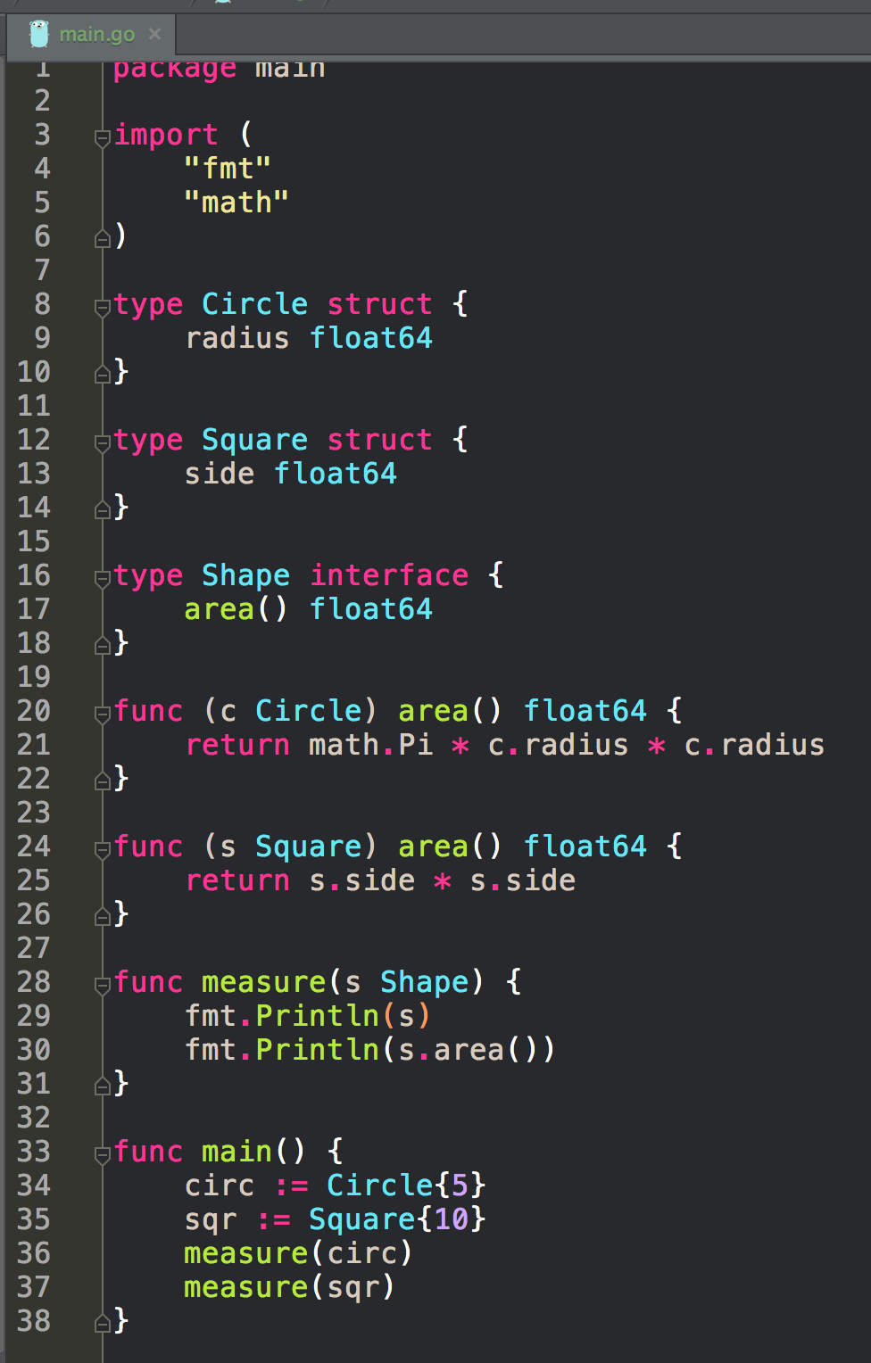
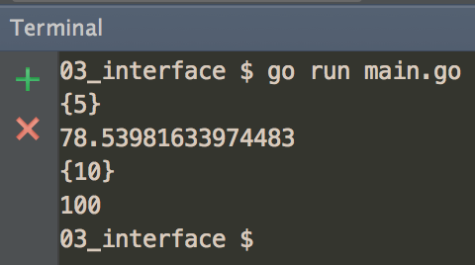
Because func measure has type Shape as a parameter, anything that implements the Shape interface can be passed into this func

Slide 26
Polymorphism
“In programming languages and type theory, polymorphism (from Greek πολύς, polys, "many, much" and μορφή, morphē, "form, shape") is the provision of a single interface to entities of different types. A polymorphic type is one whose operations can also be applied to values of some other type, or types.”
~ Wikipedia
Because func measure has type Shape as a parameter, anything that implements the Shape interface can be passed into this func

Slide 27
Different Types
Different Functions
common interface
any of the types on the left
can be matched with any of the functions on the right
because all of the functions share a common, agreed upon way of interfacing with each other

Slide 28
Different Types
Different Functions
Types that implement the io.Reader interface
Functions that take an io.Reader interface as an argument
common interface
io.Reader interface
any of the types on the left
can be matched with any of the functions on the right
because all of the functions share a common, agreed upon way of interfacing with each other

Slide 29
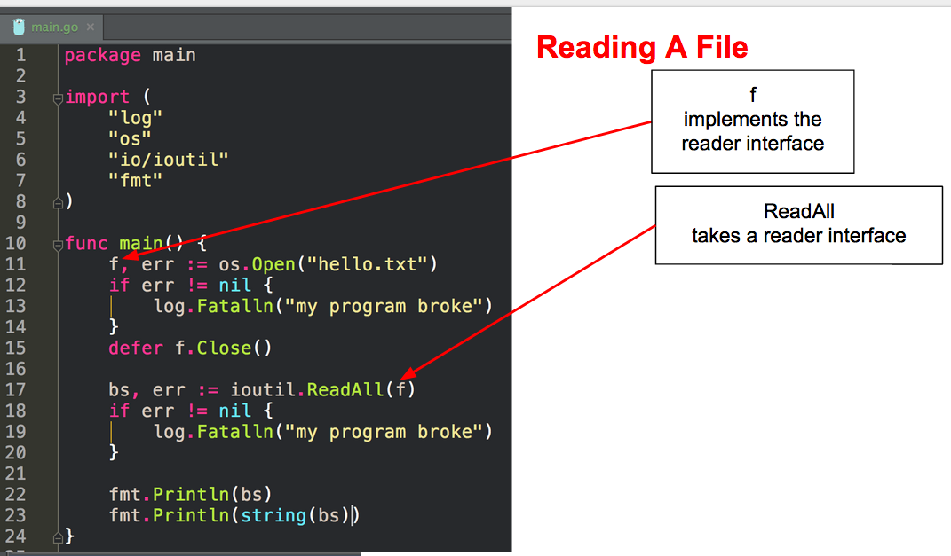

Slide 30
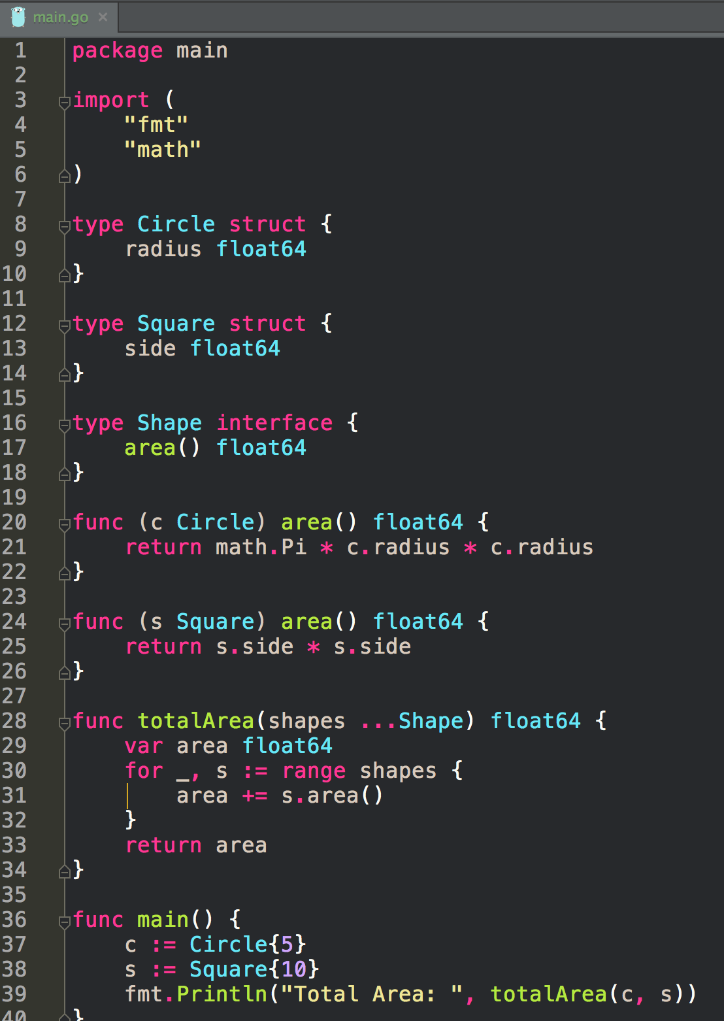
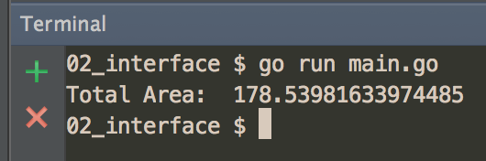
Because func totalArea has type Shape as a variadic parameter, anything that implements the Shape interface can be passed into this func

Slide 31
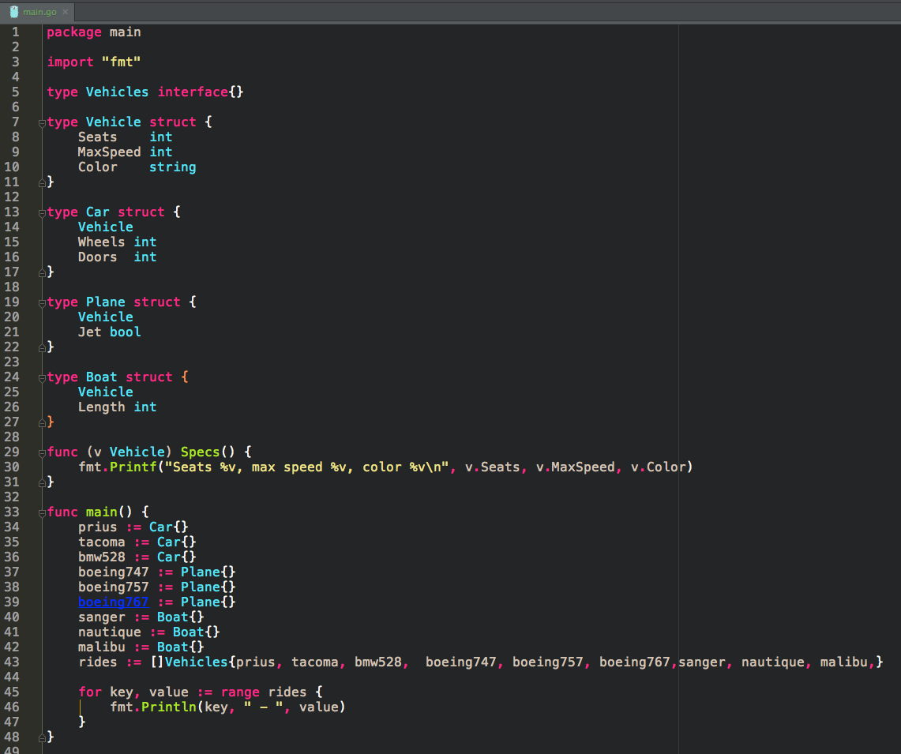
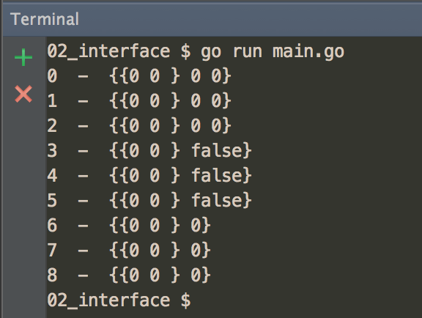
Everything implements
the empty interface

Slide 32
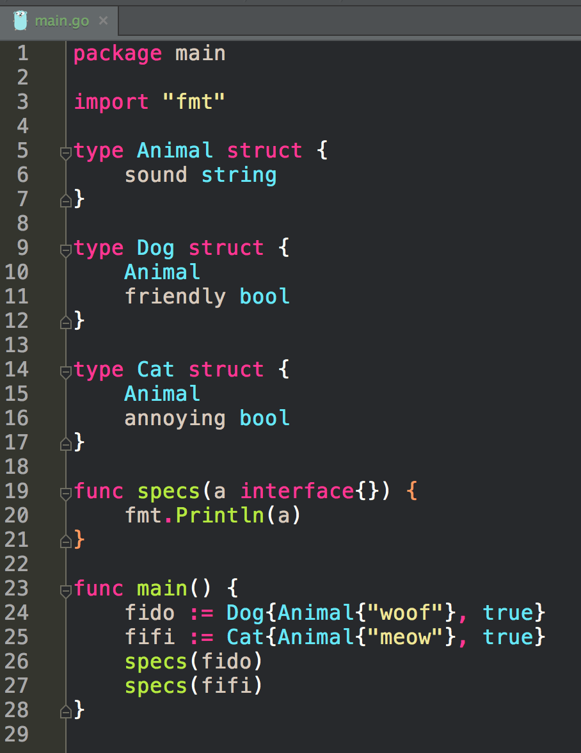
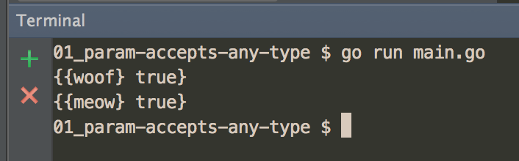
Everything implements
the empty interface

Slide 33
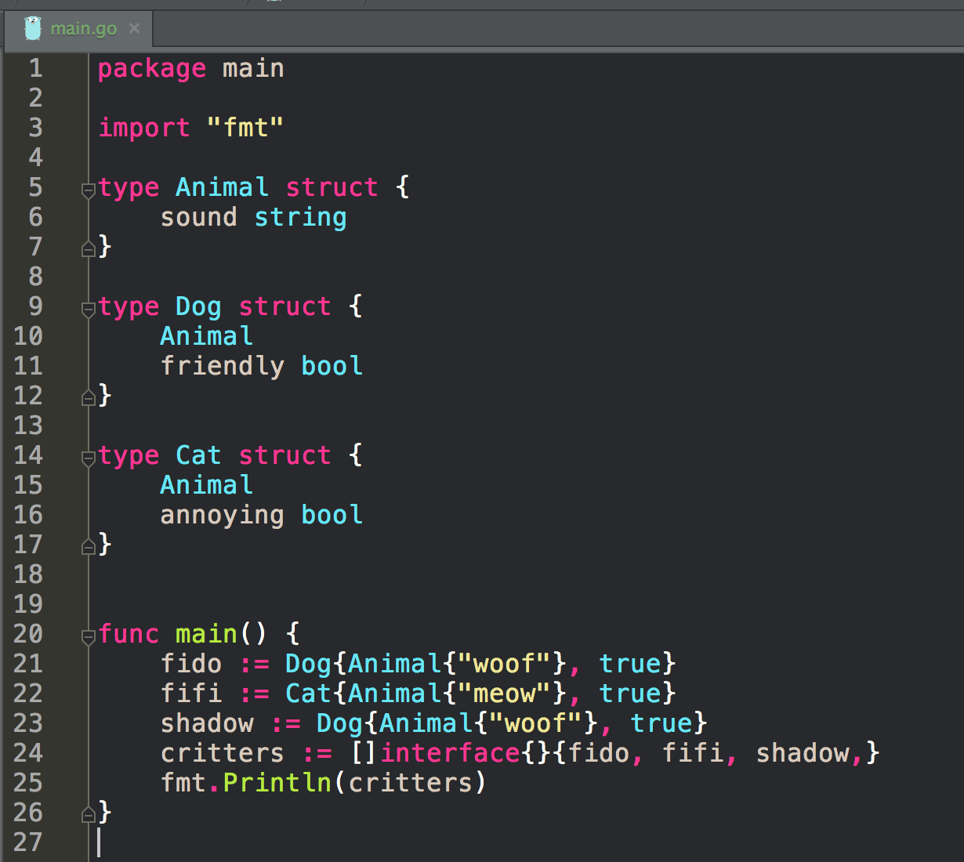
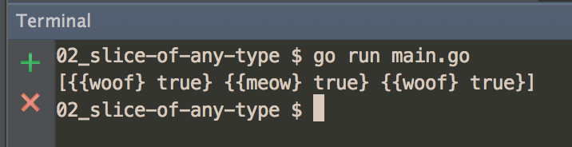
Everything implements
the empty interface

Slide 34
exercise
write a program
that uses an anonymous interface
to store any type in a slice

Slide 35
exercise
write a program
that has a function that uses an anonymous interface as a param
demonstrate that function being used
with different types

Slide 36
interfaces
in more depth

Slide 37
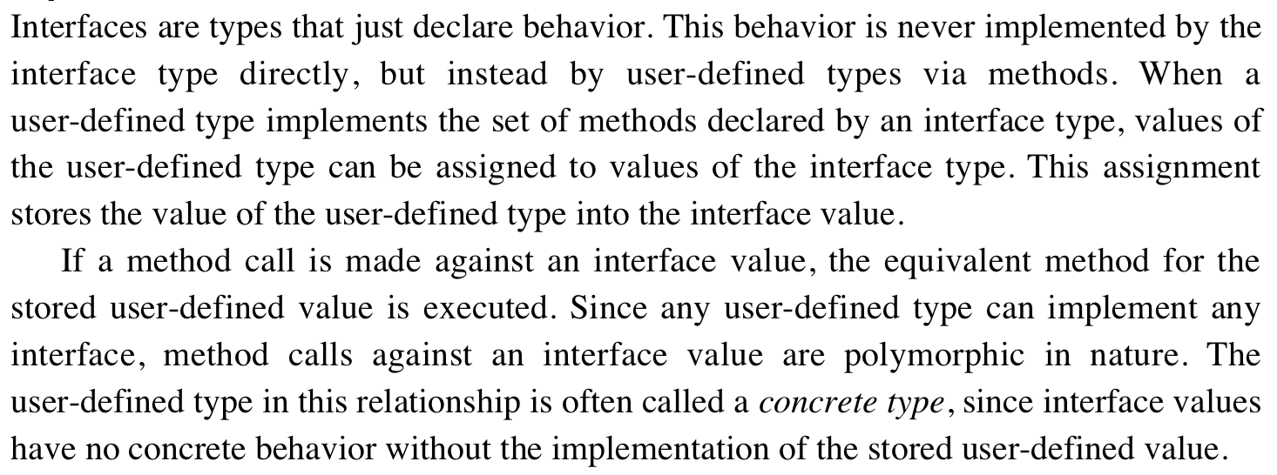


Slide 38
Implementation Details
Interface:
two-word data structure
first word
pointer to an internal table called an iTable
contains information about the stored value
the type
associated methods
second word
pointer to the stored value

Slide 39
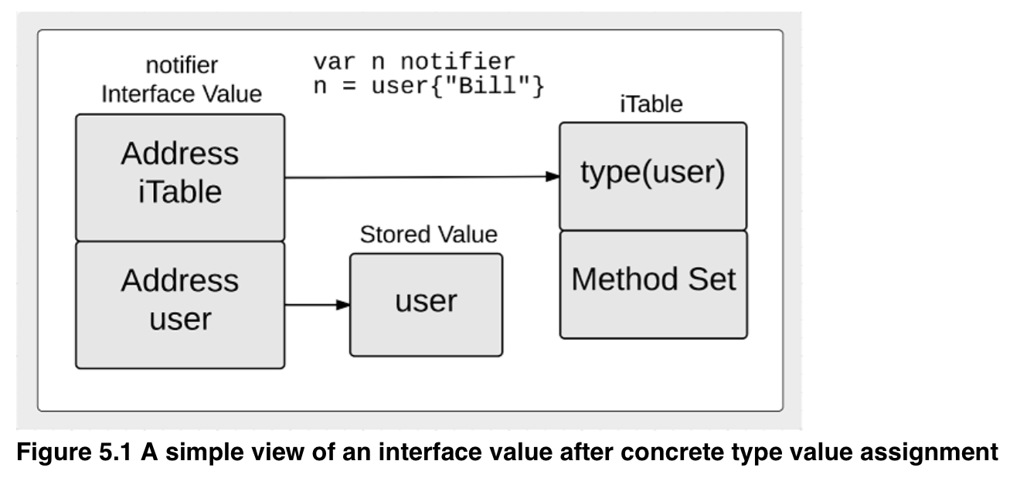
Implementation Details
Interface:
two-word data structure
first word
pointer to an internal table called an iTable
contains information about the stored value
the type
associated methods
second word
pointer to the stored value

Slide 40
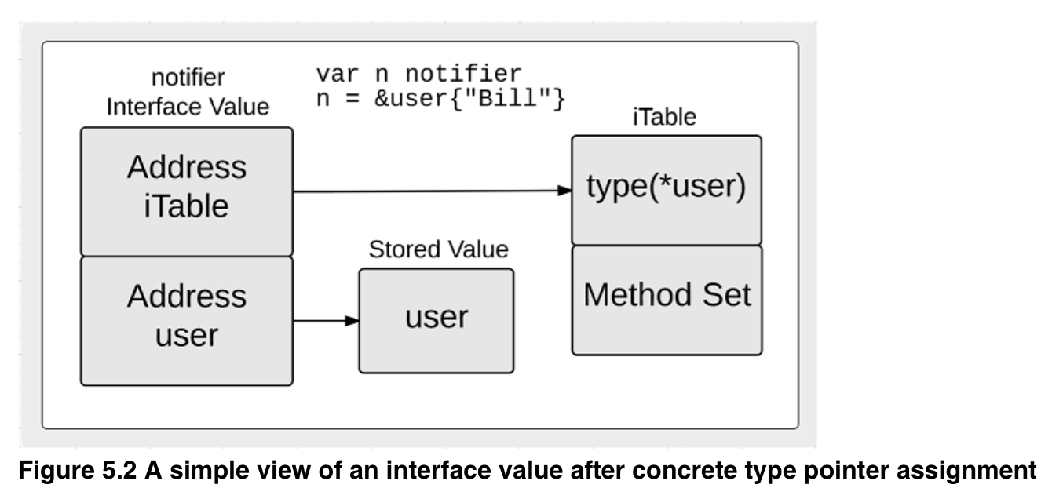
Implementation Details
Interface:
two-word data structure
first word
pointer to an internal table called an iTable
contains information about the stored value
the type
associated methods
second word
pointer to the stored value

Slide 47
Review
interface type
an interface defines a set of methods

Slide 48
Review Questions

Slide 49
interfaces
How would a bike, truck, and car all implement the vehicle interface?

Slide 50
interfaces
In your own words, describe why interfaces are useful.

